Slide 1
New Features
of
TLG Series HYRITE LED Power Supply
Innovations for Enhanced LED Lighting Solutions

Slide 2
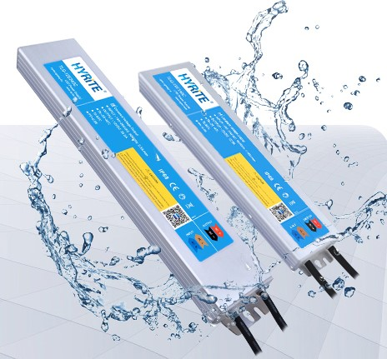
Welcome everyone to this presentation on the latest features of our TLG series HYRITE LED power supply. These innovations are designed to provide enhanced LED lighting solutions for various applications. Let's dive in.
Introduction

Slide 3
Star-Link Power Supplies
Parallel Connection: Our power supplies support parallel connection, allowing the outputs of multiple units to be connected (+ to +, - to -). This flexibility enables them to be installed anywhere in an application.

Slide 4
Star-Link Power Supplies
'N+1' Working Mode: By adding a redundant power supply in parallel (N+1), we ensure uninterrupted LED lighting even if one unit fails, reducing downtime and maintenance.

Slide 5
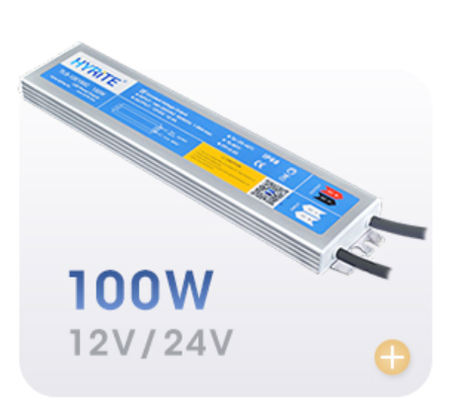
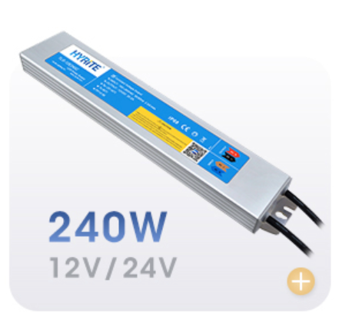
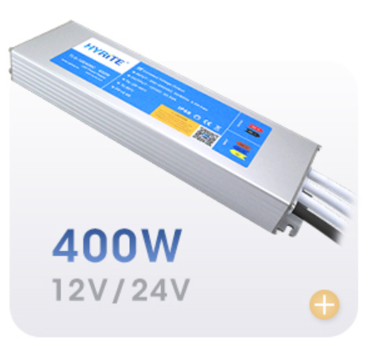
Star-Link Power Supplies
+
+
Streamlined Stocking: Our clients have the freedom to design power supply placement, minimizing stocking concerns. This flexibility permits versatile combinations for different applications (with the exception of the 60W model or lower).

Slide 6
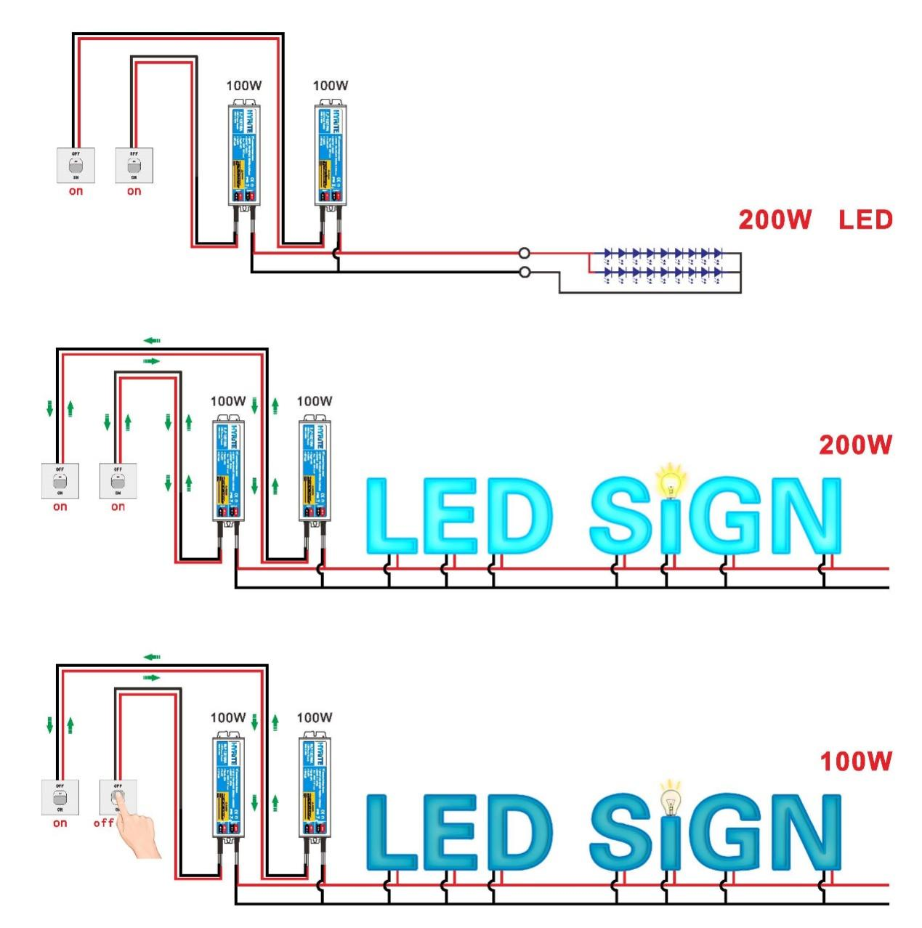
The "Never Shut Down" Feature
Limitation of Overload Protection: Traditional overload protection can lead to LED malfunctions when the power supply shuts down or flickers under excessive load.
Keep the Light Always On: Our innovative protection reduces the output when an overload is detected, maintaining the LED light while slightly dimming it. This enhances the reliability of LED signs and lighting applications.
Reduced Maintenance: This feature offers a potential "maintenance-free" solution (requires output parallel connection), saving on service costs.

Slide 7
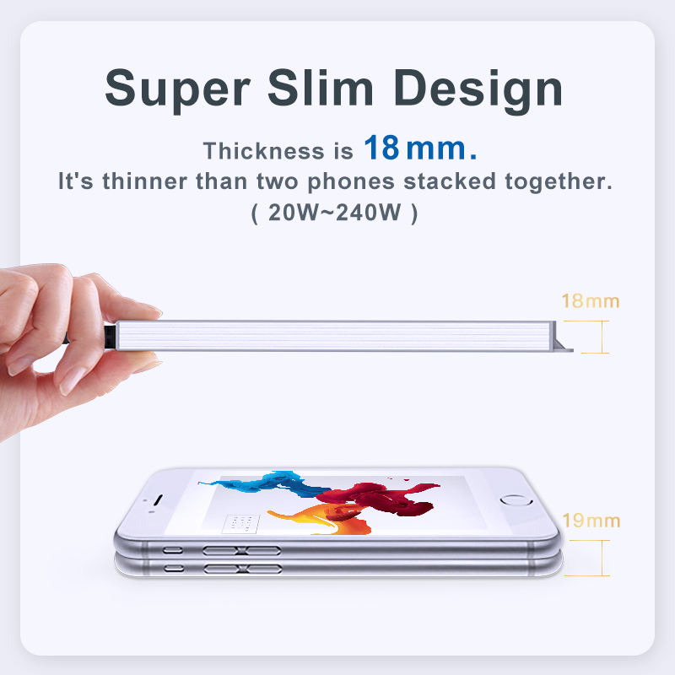
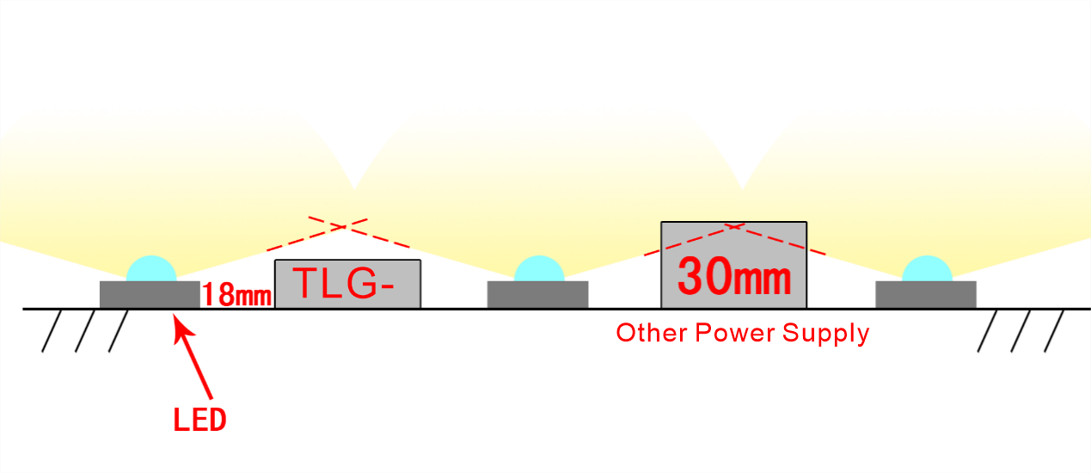
Thinner Design of TLG Series
18mm Slim Body: The TLG series boasts a super-slim design, measuring only 18mm in height (for 60-240W models). This feature facilitates easy installation inside letters or lightboxes, reducing shadows and dark areas on signs.
Versatile Application: The slim profile makes TLG series power supplies suitable for projects with space limitations, expanding their use in various applications.

Slide 8
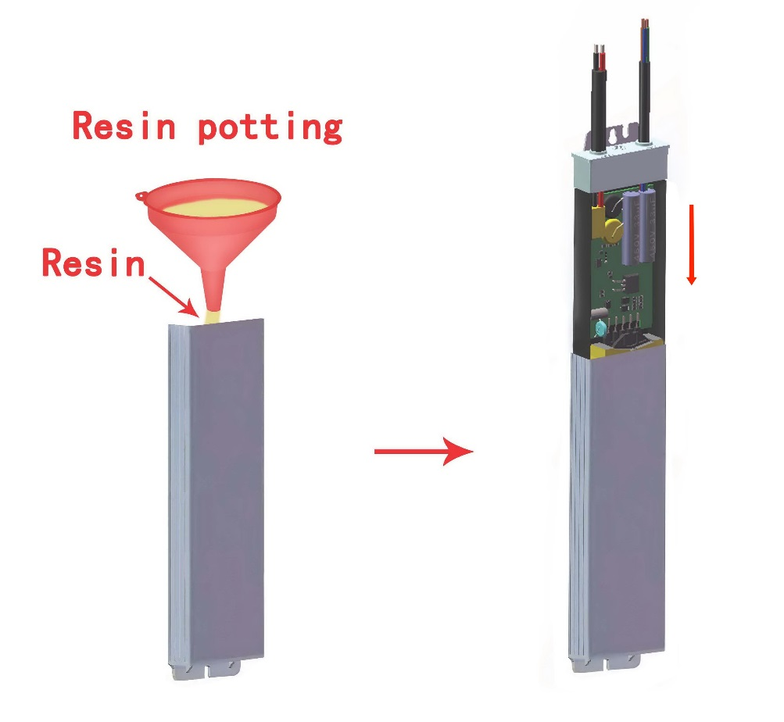
High Ingress Protection (IP68)
Enhanced Waterproofing: TLG series power supplies offer a higher IP rating (IP68) compared to regular IP67 products. This is achieved through a unique body structure and potting process.
Reduced Component Vulnerability: Input and output leads exit from the same side, and resin is potted before the PCB is fully submerged. This minimizes air bubbles around components, enhancing reliability.
New Market Opportunities: The IP68 rating opens doors to applications requiring superior waterproofing, such as water springs and swimming pools, while also reducing failures in regular outdoor settings.

Slide 9
Conclusion
In conclusion, our TLG series Hyrite LED power supplies introduce groundbreaking features for LED lighting applications, including "Star-Link" flexibility, the "Never Shut Down" safeguard, a slim design for versatile placement, and an enhanced IP68 rating. These innovations ensure superior performance and reliability for a wide range of projects.
Thank you for your attention!

Slide 10
THANK YOU!
WWW.HYRITE.EU

